Slide 1
Scaling Logstash using OpenShift
Steve Malenfant

Slide 2
What is Logstash?
Acquired by Elastic, integrated in the Elastic stack (ELK)
Ingest, transform and push for any types of events
Used extensively for our CDN pipeline
Ingest syslog
Pull logs from Kafka
Transforms and enrich unstructured events in structured format
Push logs and metrics to Elastic

Slide 3


Logging pipeline

Slide 4
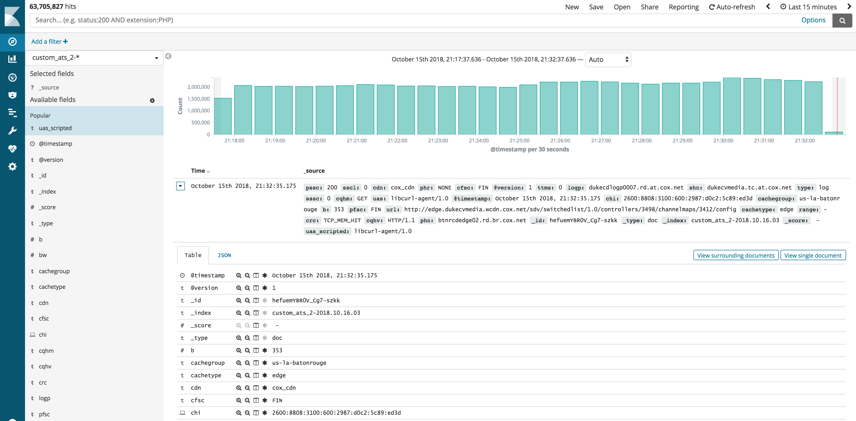

Slide 5
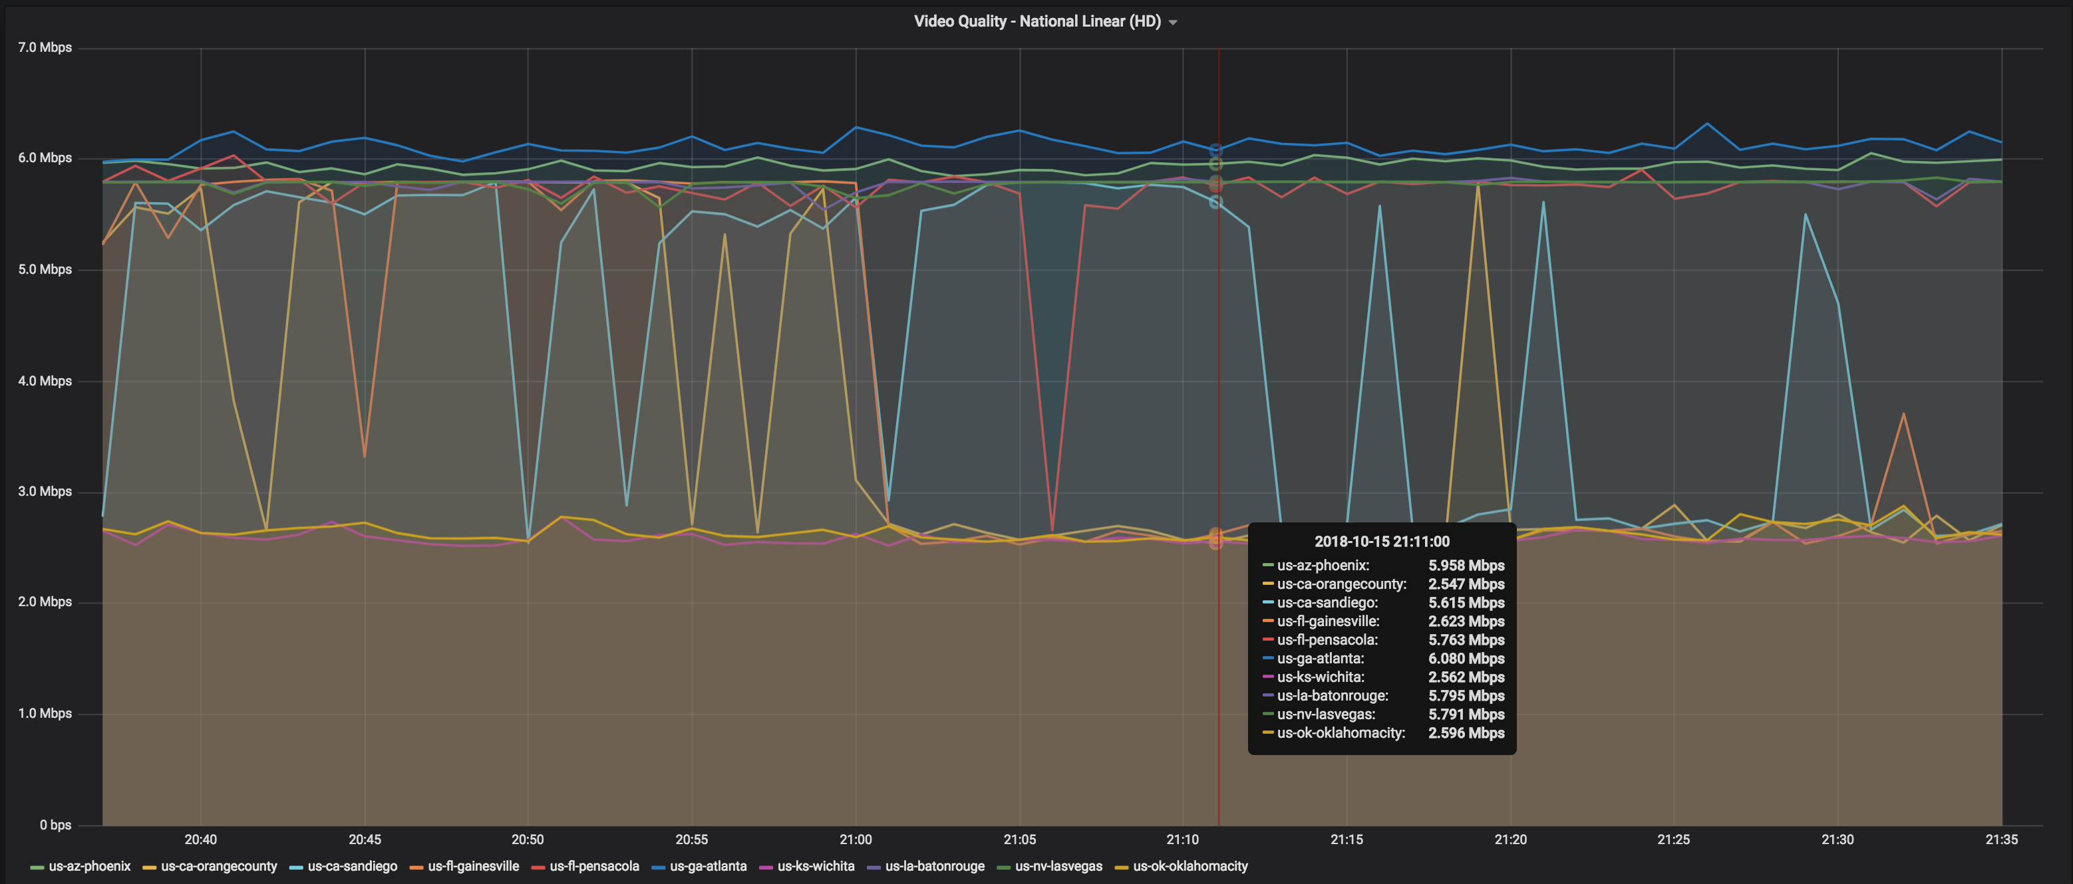

Slide 6
Logstash transformation
Split Traffic Server key/value logs line (kv filter)
Calculate approximate profile bitrate for a linear stream
Based on the bytes transferred and knowledge about segment duration
Raw ruby code + GROK
Remove unnecessary fields/tags
HTTP Header extractions

Slide 7
Evolution – Prior to today
RPM installation and templates (Ansible)
Docker on Virtual Hosts
Ansible using Docker within LXC Containers
Enabling pipelines

Slide 8
OpenShift - PaaS
Built for containers
Enable auto-scaling based on resources utilization
Health Checking
Easy deployment
Supported by the Enterprise

Slide 9
Centralized pipeline management
X-pack feature ($)
Define via Environment variables

Slide 10
ELK Stack Demo - OpenShift
Install OpenShift client
brew install openshift-cli
Bring up cluster
oc cluster up
Create project
oc new-project elk-stack
Install Elasticsearch + Kibana
oc new-app --docker-image=docker.elastic.co/elasticsearch/elasticsearch:6.4.2
oc new-app --docker-image=docker.elastic.co/kibana/kibana:6.4.2
Expose Kibana http://kibana-logstash.127.0.0.1.nip.io
oc expose elk-stack/kibana

Slide 11
ELK Stack Demo - OpenShift
Install the configuration maps for logstash
oc create configmap logstash-config --from-file=config/
oc create configmap logstash-pipelines --from-file=pipelines/
Bring up logstash
oc create -f logstash.yml
Done!

Slide 12
Logstash configuration and pipelines
$ ls -l config/
total 40
-rw-r--r-- 1 smalenfa staff 1891 Oct 16 08:46 jvm.options
-rw-r--r-- 1 smalenfa staff 552 Oct 16 08:47 log4j2.properties
-rw-r--r-- 1 smalenfa staff 252 Oct 16 11:00 logstash.yml
-rw-r--r-- 1 smalenfa staff 133 Oct 16 11:09 pipelines.yml
-rw-r--r-- 1 smalenfa staff 1743 Oct 16 08:48 startup.options
$ ls -l pipelines/
total 16
-rw-r--r-- 1 smalenfa staff 1587 Oct 16 14:51 access_traffic_router.conf
-rw-r--r-- 1 smalenfa staff 1194 Oct 16 13:38 access_traffic_router.template

Slide 13
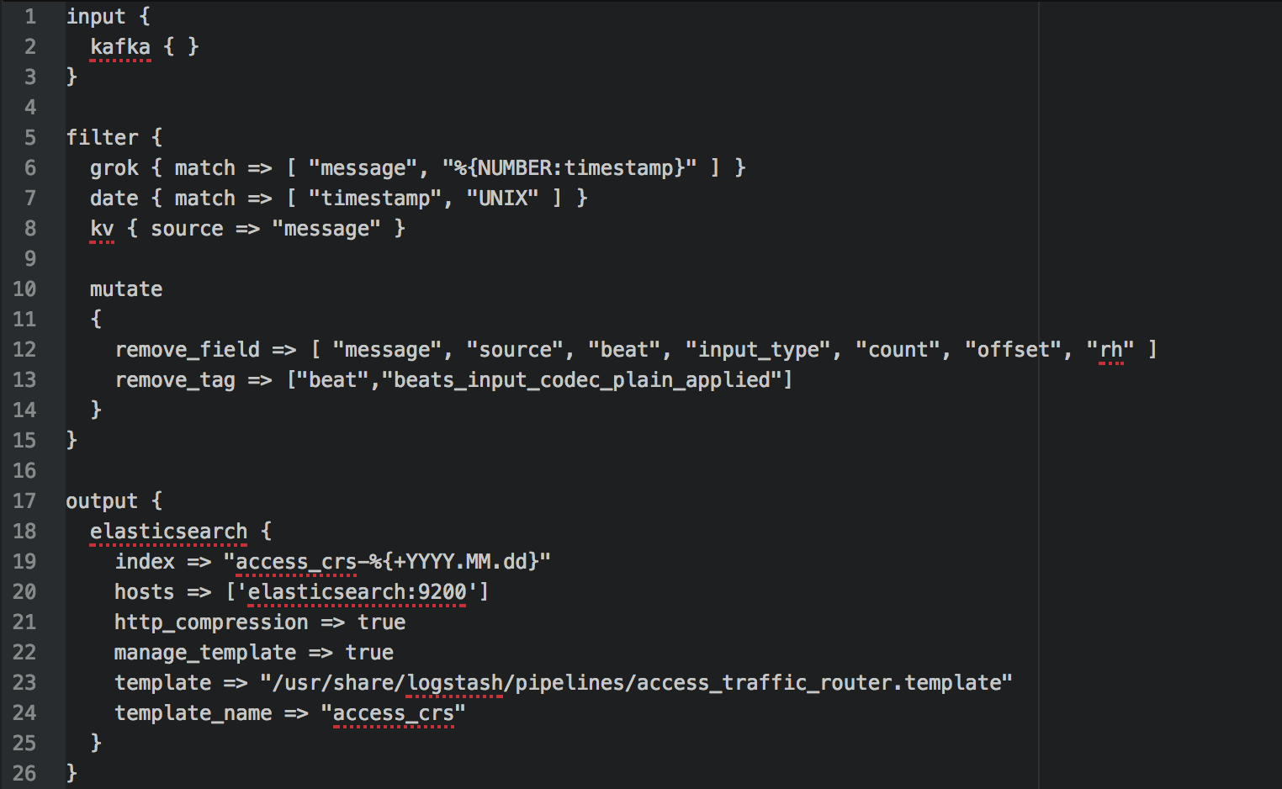
Traffic Router Pipeline

